Slide 1


Project: Finance
Analysis on bank Marketing
Submitted by : Gayatri Jitendra Patil

Slide 2
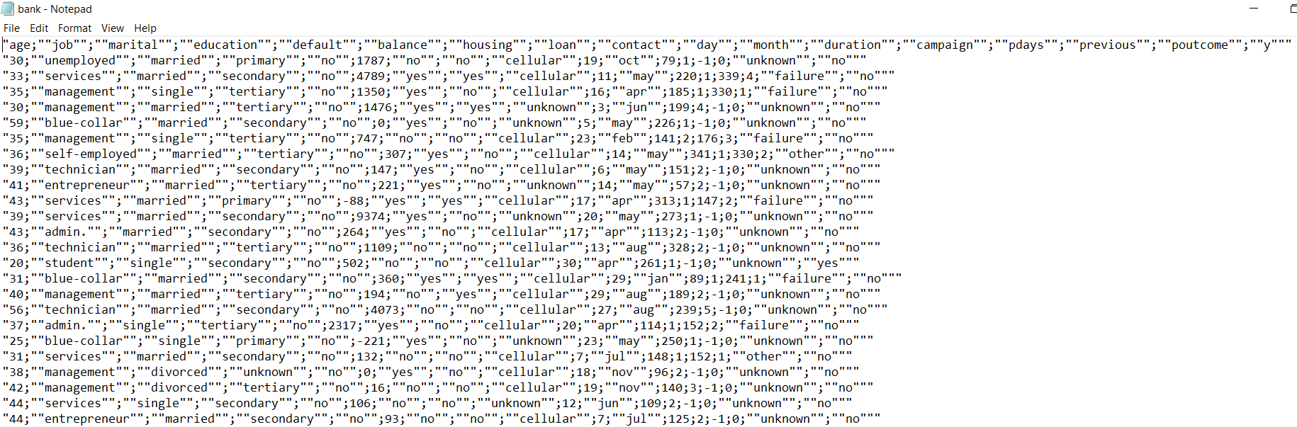
Problem Definition
Dataset:
Problem Statement : The problem is that the Bank Marketing campaigns of a Portuguese banking institution need to identify the factors that cause the customers to tend to take the subscription, as well as Bank Marketing campaigns of a Portuguese banking institution need to identify the reasons behind the customer which make them not take the subscription.

Slide 3
Data Set Description
Bank Marketing: The data is related to direct marketing campaigns of a Portuguese banking institution. The marketing campaigns were based on phone calls. Often, more than one contact with the same client was required to assess if the product (bank term deposit) would be (or not) subscribed.

Slide 4
Business Importance of Problem
Financial statements are a great way to monitor the performance of a company. They provide information about the company’s financial standing and how they are doing financially.In order to run a successful business, one requires money for numerous goals, such as:
To acquire new machinery/equipment
Recruiting and training staff
Increasing the company’s commercial opportunities
To keep inventory increases

Slide 5
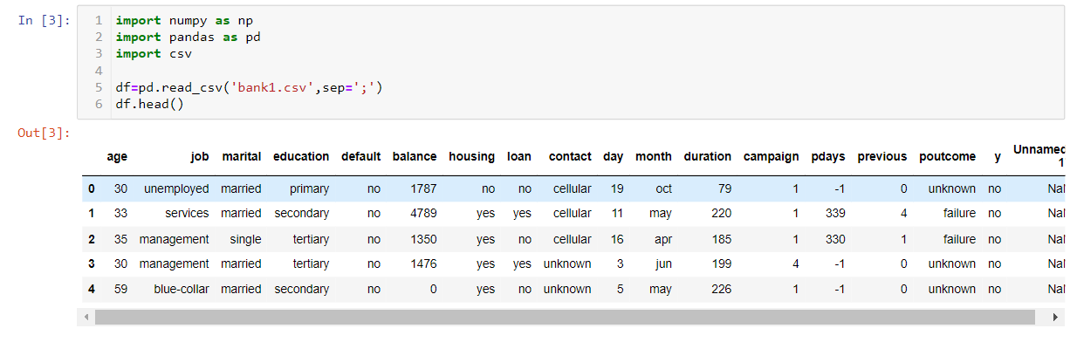
Project Flow – Question 1
1. Import data sets and Load data set

Slide 6
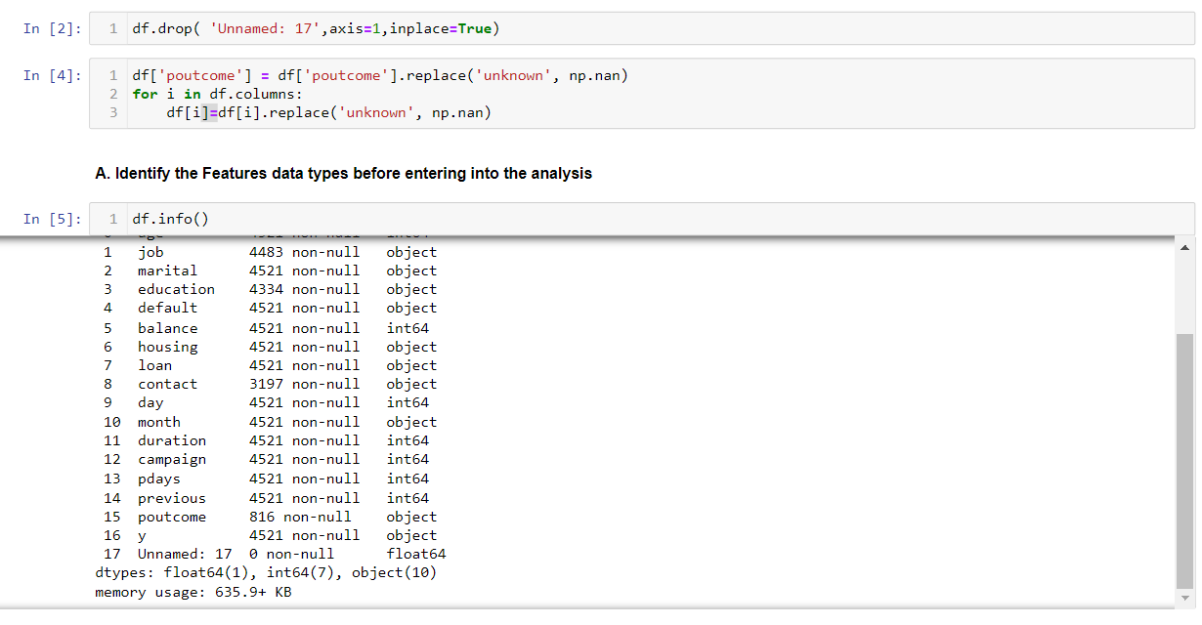
Project Flow – Question 2
2. Make the data proper to make use of data for analysis

Slide 7
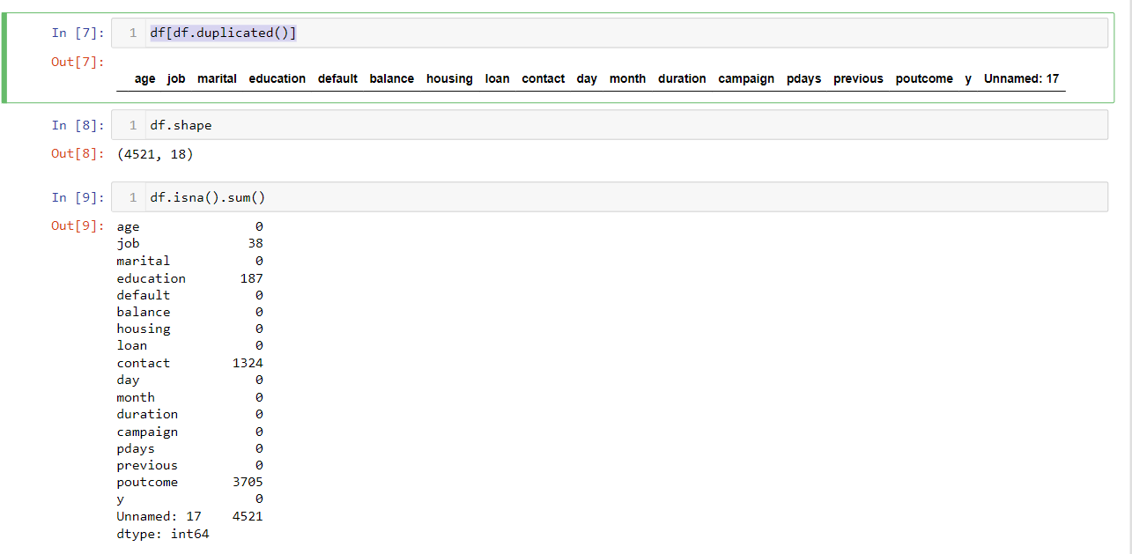
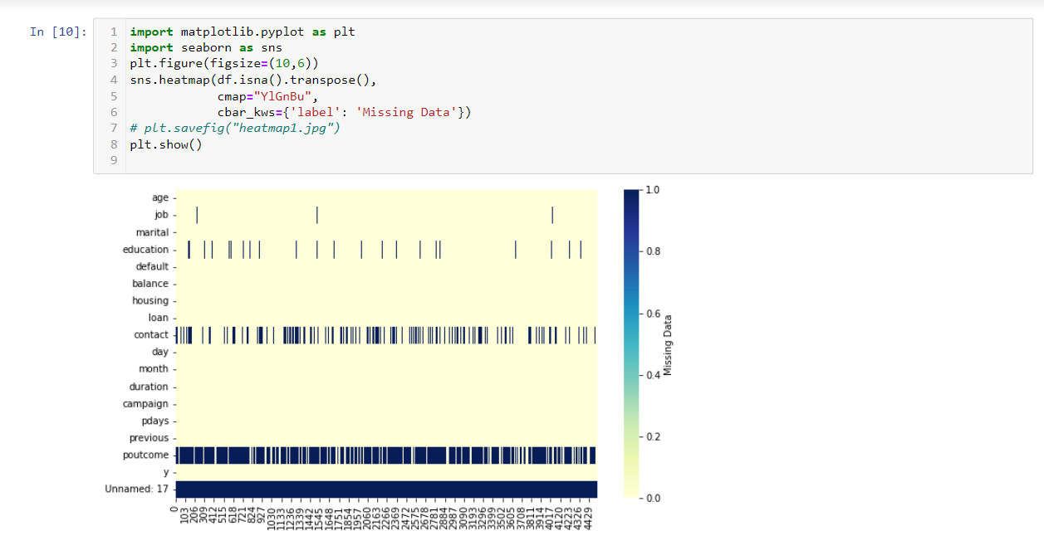
Project Flow – Question 2- b,c,d
Convert the datatypes which are wrongly identified according to the business(domain). Kindly use the User Defined function and loop to convert the data types once.
Answer:- data is already according identified according to the business(domain).
Find and Remove missing if any. Use visualization to find the missing values or Use general method to find the missing values.
Find duplicates (if necessary)

Slide 8
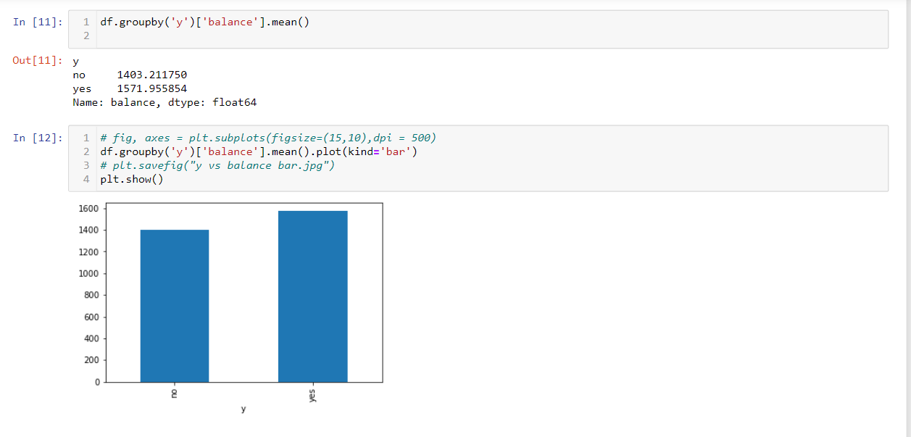
Project Flow – Question 3
3. Find the average balance of the customer who belongs to the subscribed customer and non-subscribed customer and also use a related plot to show them in visualization.

Slide 9
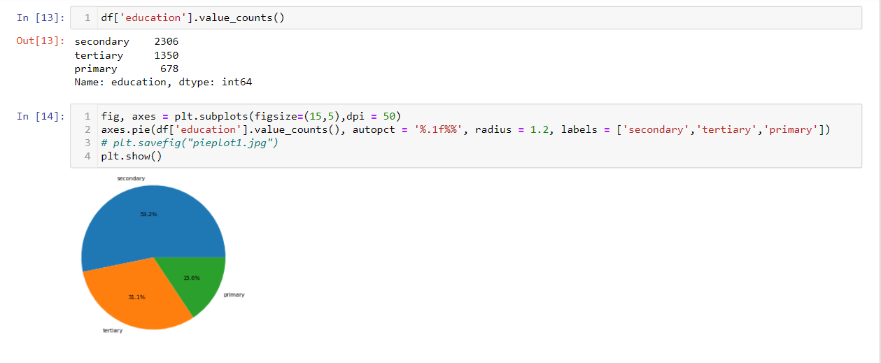
Project Flow – Question 4
4. Use a pie plot to find the distribution(frequency) of the education. Make sure to add labels and show the percentage of each education distribution.

Slide 10
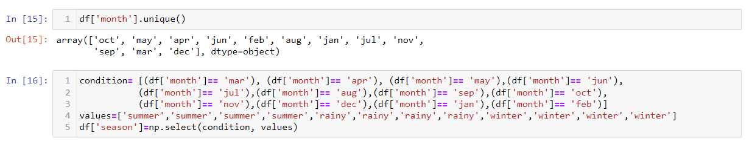
Project Flow – Question 5
5. Create a function that should be able to create a new feature(Variable) called season using the month column.

Slide 11
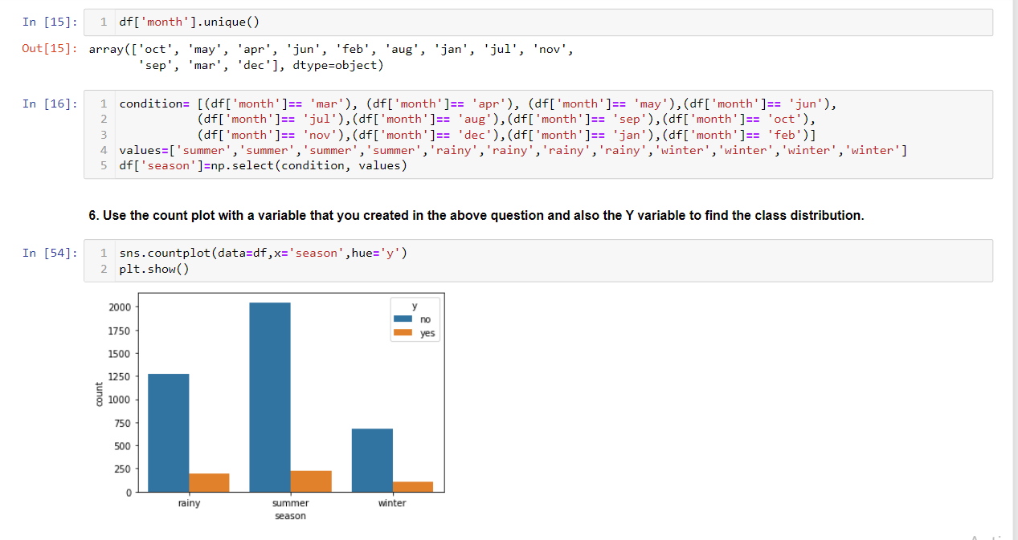
Project Flow – Question 6
6. Use the count plot with a variable that you created in the above question and also the Y variable to find the class distribution.

Slide 12
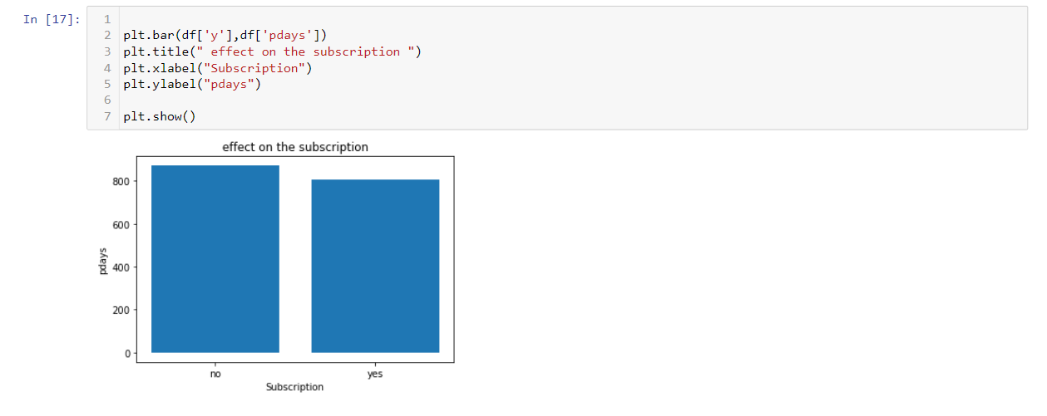
Project Flow – Question 7
7. Use the Pdays feature and find does it cause any effect on the subscription of the term using the bar plot.

Slide 13
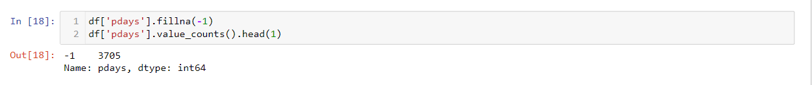
Project Flow – Question 8
8. Replace the -1 as nan values for the P-days store.

Slide 14
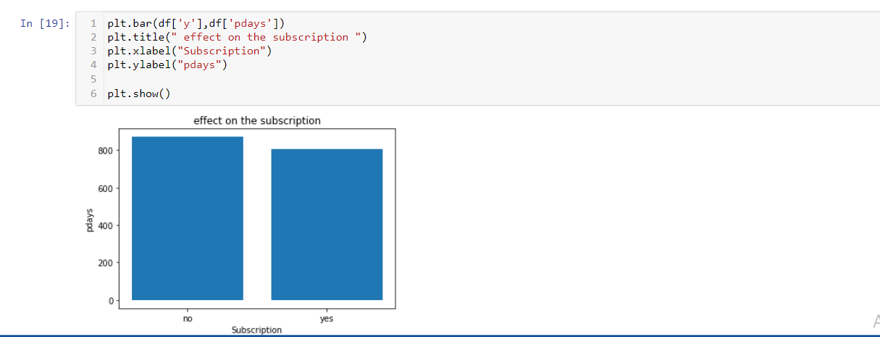
Project Flow – Question 9
9. Once you are done with question number 8, do the same analysis as question number 7. And observe the difference between question number 7 and question number 9.
Inference:- there is no difference in both plot with and without null value

Slide 15
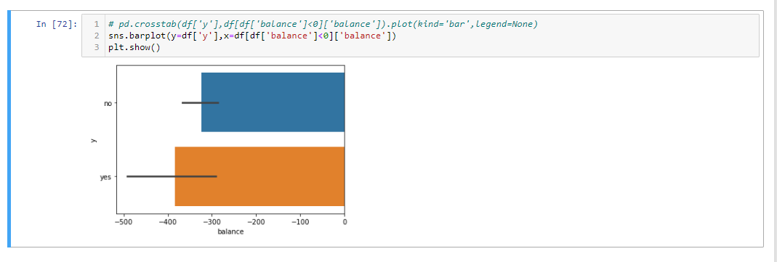
Project Flow – Question 10
10. Does the customer take the term subscription who has less than 0 balance?

Slide 16
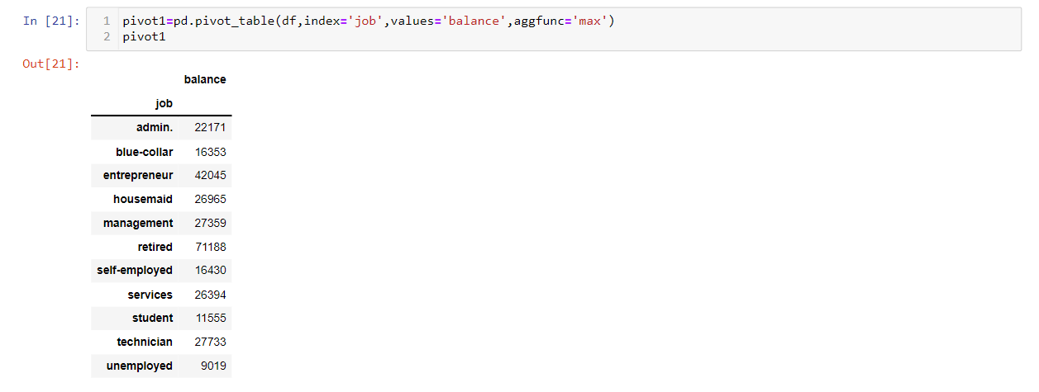
Project Flow – Question 11
11. Use Pivot table to find the maximum balance for each type of job.

Slide 17
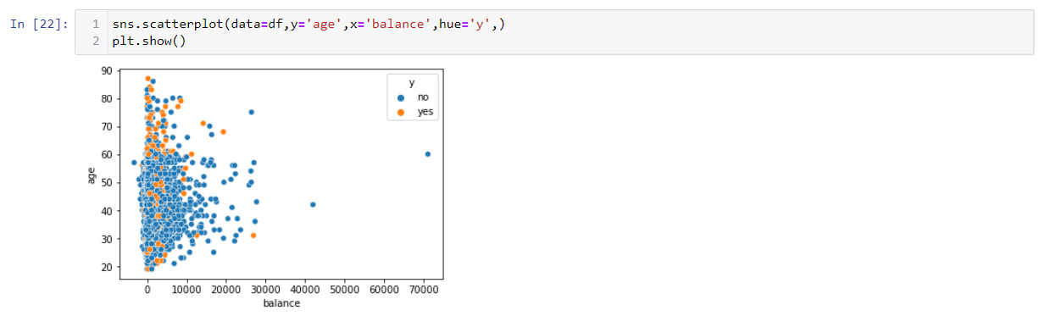
Project Flow – Question 12
12. Use the Age, balance, and Y column to plot the scatter plot and find what kind of relationship Age and balance had, and See the points which belong 0 and 1 class and how they are distributed.
Whatever the age is. There are no any such relations but the balance maximum balance is 20000
And only subscription taken people are less than 10000

Slide 18
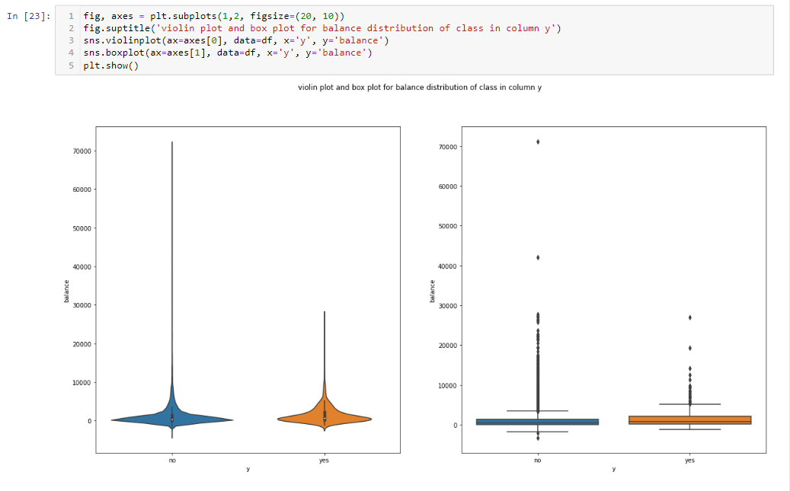
Project Flow – Question 13
13. Use the violin plot and also the box plot to find the distribution of the balance for each class of the Y column. And try to tell why we have a Violin plot and Box plot both ra
A violin plot is more informative than a plain box plot. While a box plot only shows summary statistics such as
mean/median and interquartile ranges, the violin plot shows the full distribution of the data. The difference is
particularly useful when the data distribution is multimodal (more than one peak).
In this case a violin plot shows the presence of different peaks, their position and relative amplitude

Slide 19
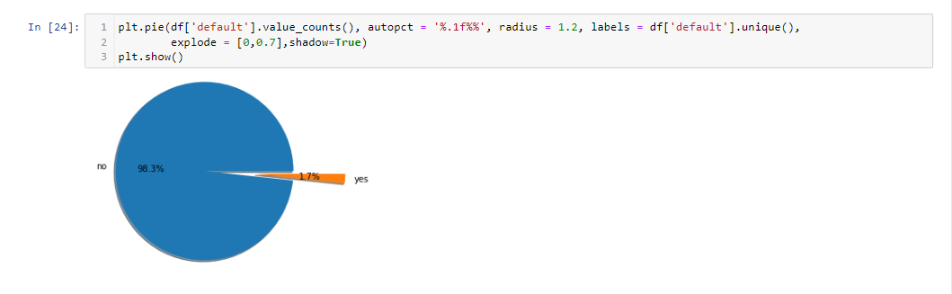
Project Flow – Question 14
14. Use a pie plot to know the Proportion(distribution) of the defaulters and non-defaulters.

Slide 20
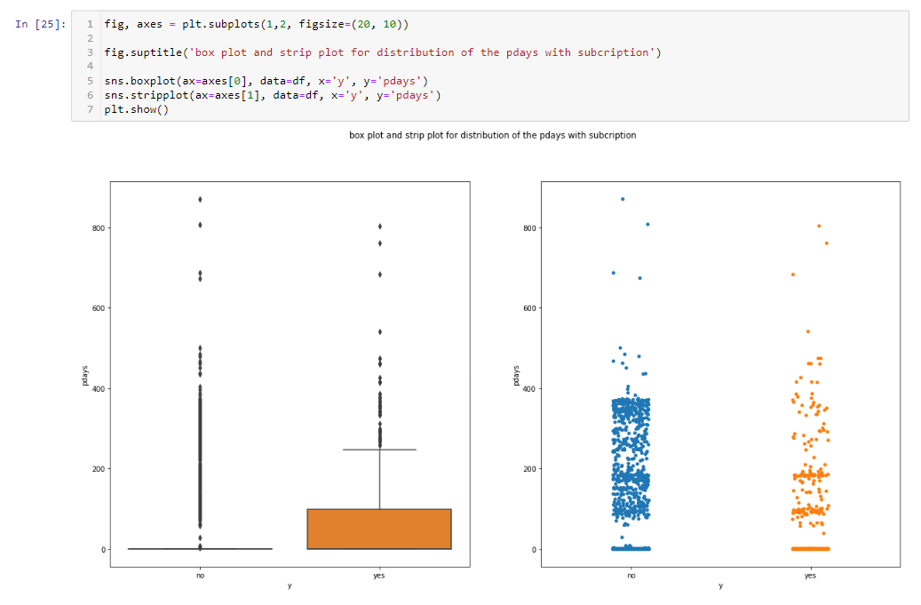
Project Flow – Question 15
15. Use Box plot and strip plot to know the distribution of the Pdays with respect to Y classes and differentiate both plots.
The strip plots show all the data at that level of theory. The box plots show the extrema (whisker tails),
interquartile range (box boundaries), and median (horizontal line). The violin plots show the probability
density of the data

Slide 21
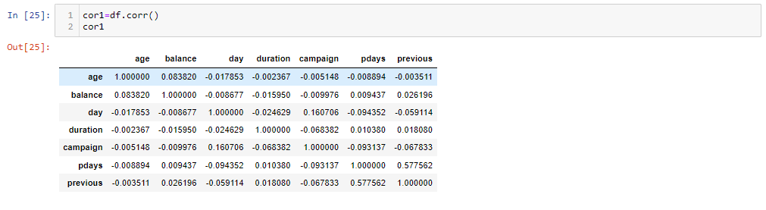
Project Flow – Question 16
16. Correlation between all numerical columns

Slide 22
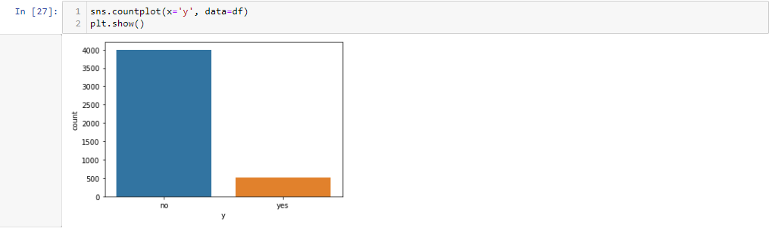
Project Flow – Question 17
17. Count of deposit subscribe by people

Slide 23
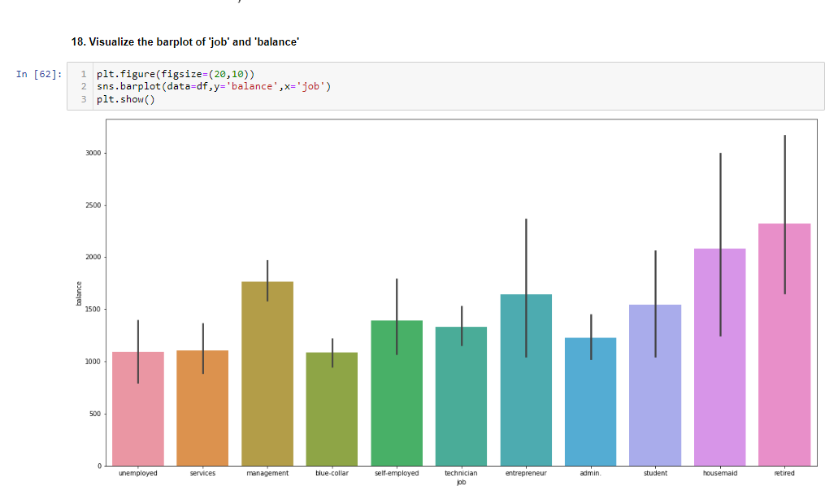
Project Flow – Question 18
18. Visualize the bar plot of 'job' and 'balance'

Slide 24
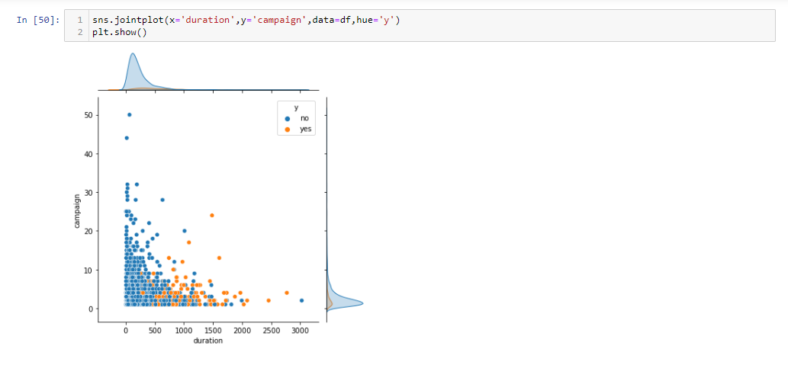
Project Flow – Question 19
19 Visualize the relationship between 'duration' & 'campaign': with response result

Slide 25
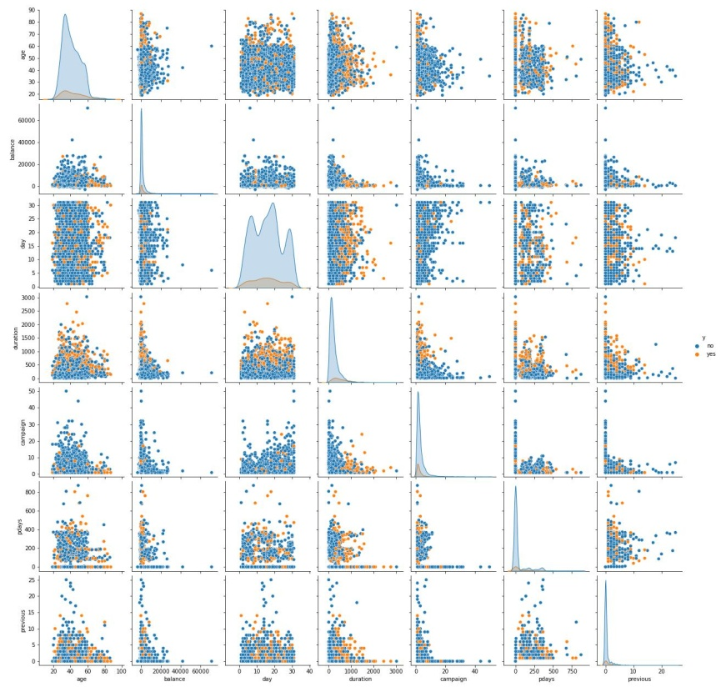
Project Flow – Question 20
20. Relation of all numeric columns with each other on y column

Slide 26
Major Challenge
The major challenge is to import dataset in pandas.

Slide 27
Conclusions
Write the lessons learned:-
Banks play very important roles in the economic development of nations as they, too a large extent, wield control over the supply of money in circulation and are the main stimuli of economic progress.
So we have learnt from this mini project that is how to prepare data inspection and cleaning
Inform then we have done so many questions about figure out the subscription loan bank account details and where it is male or female were the bank account is negative or positive and from this analytics we have use a many type of plot like bar plot ,pie plot ,scratch plot ,box plot and so on
Skills Used:-
We have to use jupyter notebook to devlop this project
We have to use numpy,pandas built in fuctions and data manipulation skills
And we have to develop the skills to know the inferences of plots
There are intense use of matplotlib and seaborn library to plot the graphs
Domain understanding developed:-
The campaigns are useful to improve banking business
Communications are very useful to grow the relation with bank and account holders

Slide 28
Thank You !!!....

